Slide 1
Merge, Join, and Concatenate with Pandas

Slide 2
Merging DataFrames
Combining data from different sources based on common columns.
Based on common values in selected column name
Requires atleast one similar column.
pd.merge() function.
Types of merges:
inner, outer, left, and right.

Slide 3
Merging DataFrames (contd)
Examples:
import pandas as pd
# Creating two sample DataFrames
df1 = pd.DataFrame({'ID': [1, 2, 3], 'Name': ['Alice', 'Bob', 'Charlie']})
df2 = pd.DataFrame({'ID': [2, 3, 4], 'Age': [25, 30, 28]})
left_merged = pd.merge(df1, df2, on='ID', how='left')
right_merged = pd.merge(df1, df2, on='ID', how='right')
outer_merged = pd.merge(df1, df2, on='ID', how='outer')

Slide 4
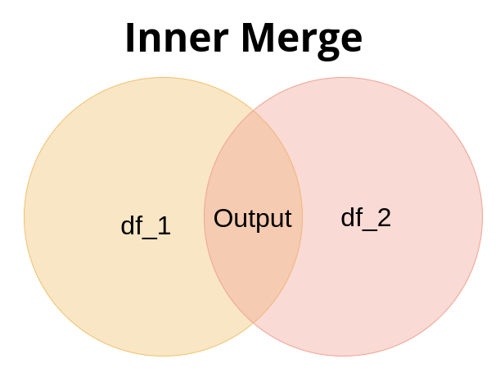
Merging DataFrames
Inner Merge: It outputs where the rows from the left and right dataframes are similar (common values). Specified by “on”.
inner_merged = pd.merge(df1, df2, on='ID', how='inner')

Slide 5
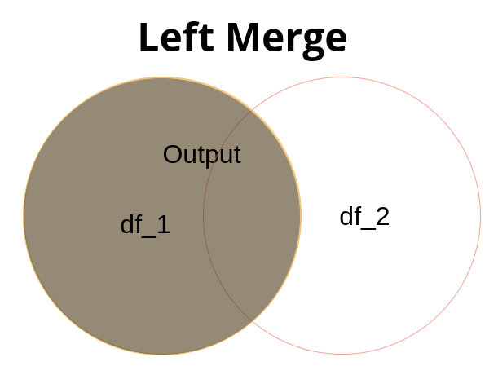
Merging DataFrames (Contd.)
Left Merge: It outputs the left df and every similar occurence in df2.
left_merged = pd.merge(df1, df2, on='ID', how='left')

Slide 6
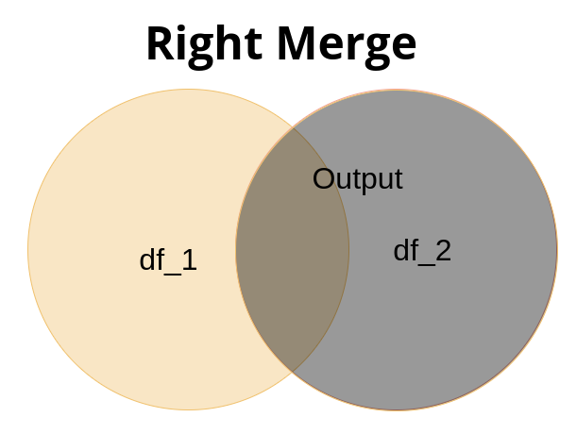
Merging DataFrames (Contd.)
Right Merge: It outputs the right df and every similar occurence in df1.
right_merged = pd.merge(df1, df2, on='ID', how='right')

Slide 7
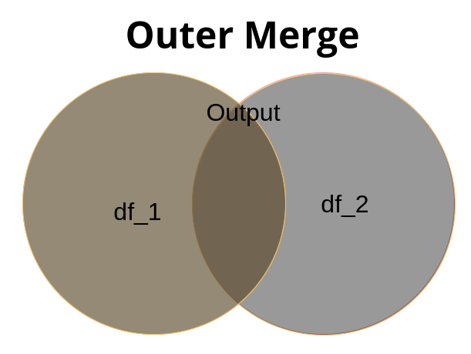
Merging DataFrames (Contd.)
Outer Merge: It is a combination of left and right join, or the output of the both df or the opposite of an inner join.
outer_merged = pd.merge(df1, df2, on='ID', how='outer')

Slide 8
Joining DataFrames
Similar to merging but based on Index.
Considers similarity in index.
df.join() method.
Used when the tables are completely unique.
Supports different types of joins.

Slide 9
Joining DataFrames (contd)
# Creating two sample DataFrames
df1 = pd.DataFrame({'Name': ['Alice', 'Bob', 'Charlie'], 'Salary': [50000, 60000, 55000]})
df2 = pd.DataFrame({'Country': ['USA', 'Canada', 'UK']}, index=['Alice', 'Bob', 'Charlie'])
inner_joined = df1.join(df2, how='inner')
left_joined = df1.join(df2, how='left')
right_joined = df1.join(df2, how='right')
outer_joined = df1.join(df2, how='outer')

Slide 10
Concatenating DataFrames
Appending DataFrames vertically or horizontally.
pd.concat() function.
Useful for combining data from different parts.

Slide 11
Concatenating DataFrames (contd)
# Creating two sample DataFrames
df1 = pd.DataFrame({'A': [1, 2, 3], 'B': [4, 5, 6]})
df2 = pd.DataFrame({'A': [7, 8, 9], 'B': [10, 11, 12]})
# Vertical concatenation
vertical_concat = pd.concat([df1, df2])
# Horizontal concatenation
horizontal_concat = pd.concat([df1, df2], axis=1)

Slide 12
Thank you!

